Slide 1

WALCHAND COLLEGE OF ENGINEERING, SANGLI
DEPARTMENT OF INFORMATION TECHNOLOGY
Topic:- Exam Data Analysis
PREPARED BY:-
1) HUZEFA M. CHABUKSWAR [2014BIT003]
NILESH C. BONDE [2014BIT059]
PIYUSH S. ATRAM [2013BIT059]
UNDER THE GUIDANCE OF :-
Prof. Mr. U. B. CHAVAN

Slide 2
Objectives:-
To analyse exam result.
Distribution of student marks on basis of various factors.
Proper visualization of exam data.
Understand basics of data analysis.
Learning Python.

Slide 3
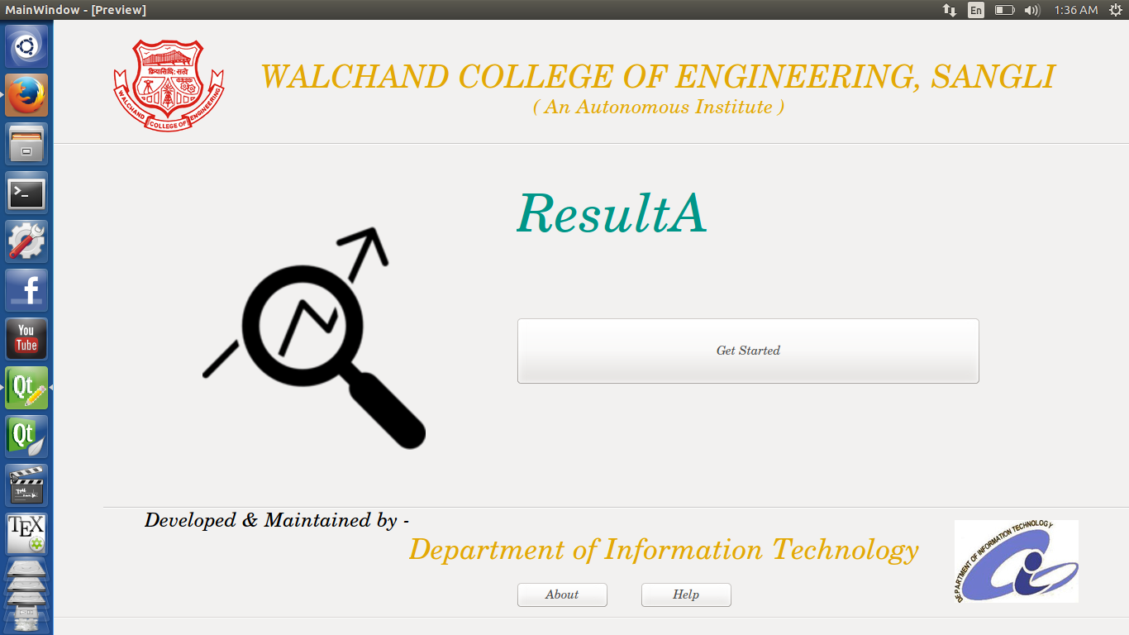
Main Window

Slide 4
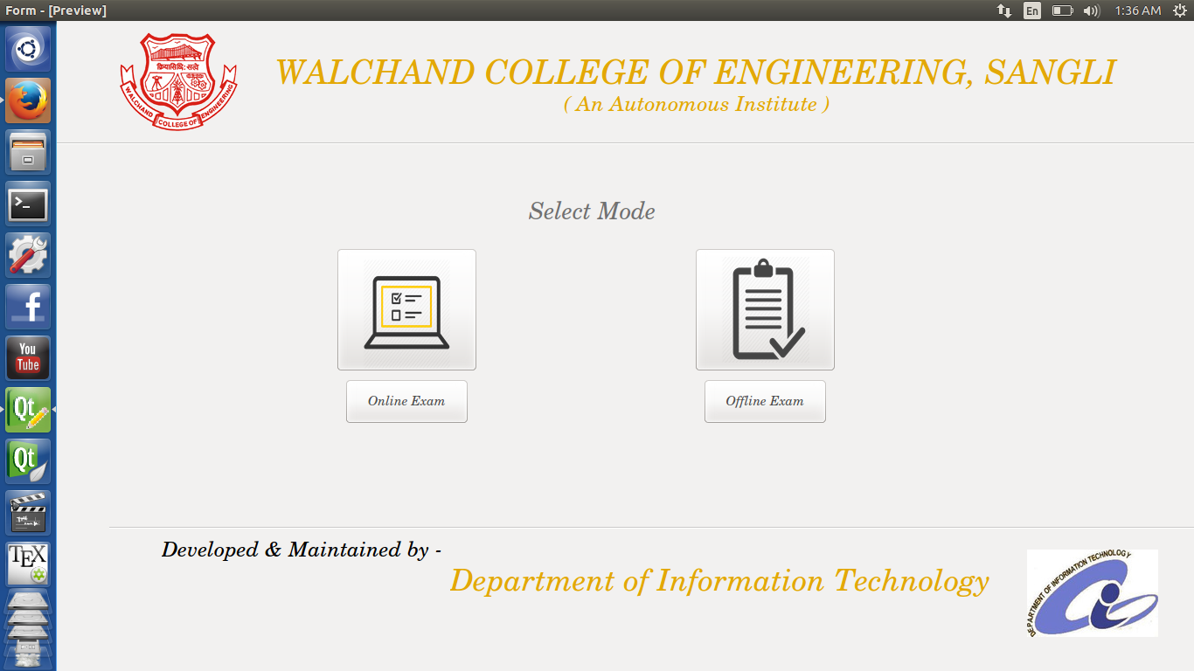

Exam type selection

Slide 5
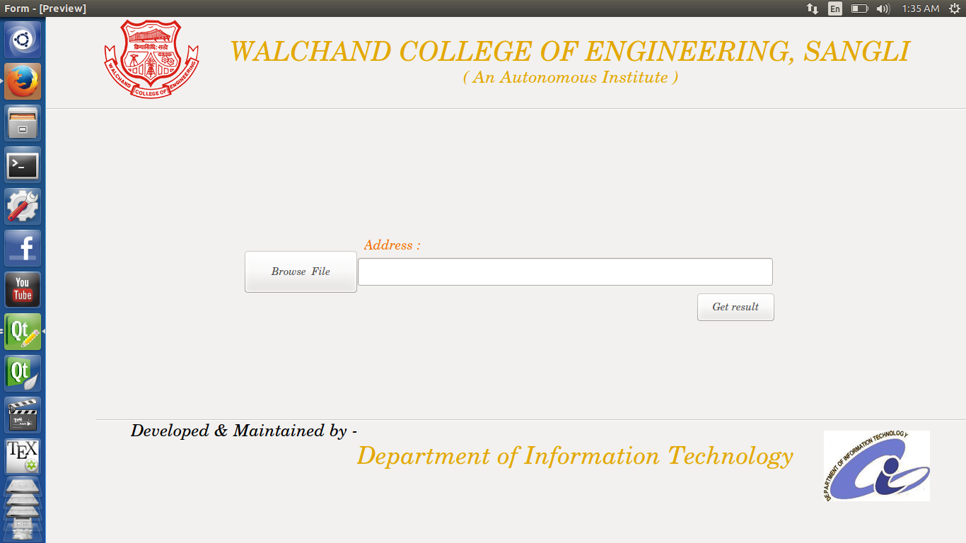
Generate result

Slide 6
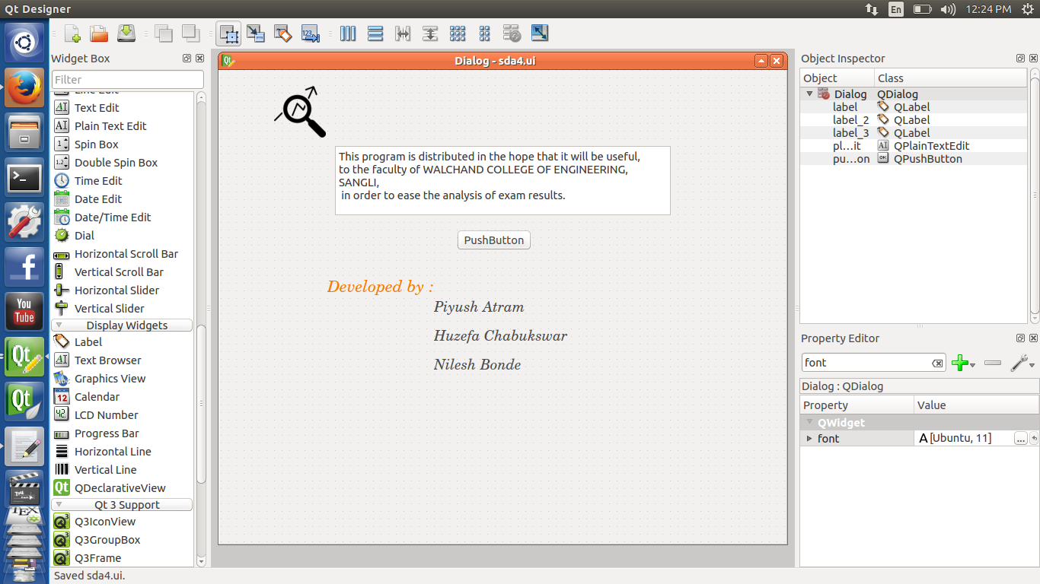
About

Slide 7
Methodology
Start
Input excel file
Read data
Calculate total marks of each
Find CO’s used in paper
Create Dictionary with ‘key’ as name of CO and initialize it with value zero(0)
for each student
Calculate CO wise marks Obtained by each student
Calculate P values, average mark, topper of subject, etc.
Write Output in the file with proper alignment
End

Slide 8
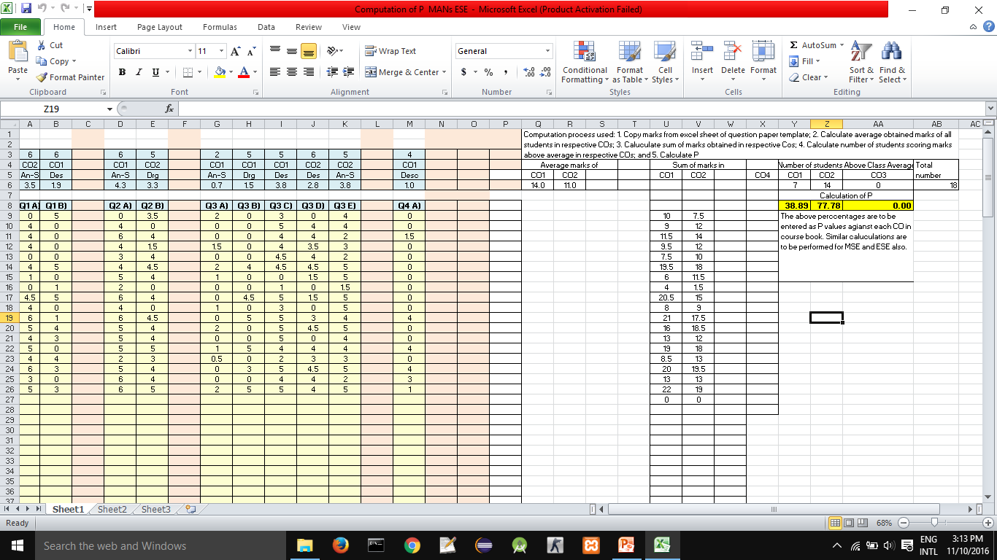

Slide 9
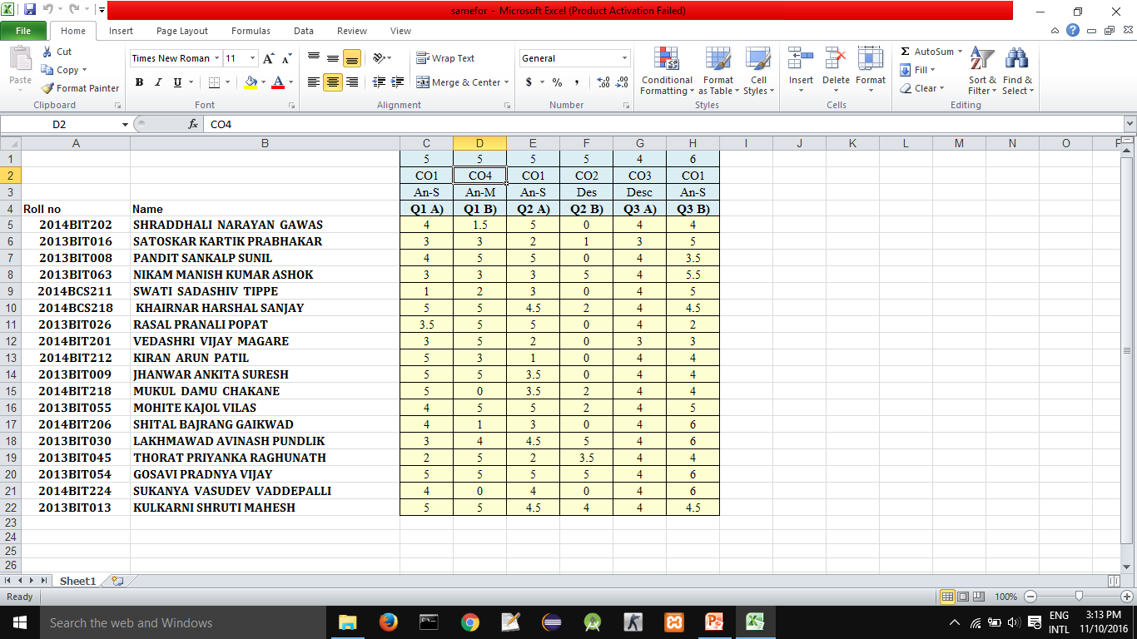

Slide 10
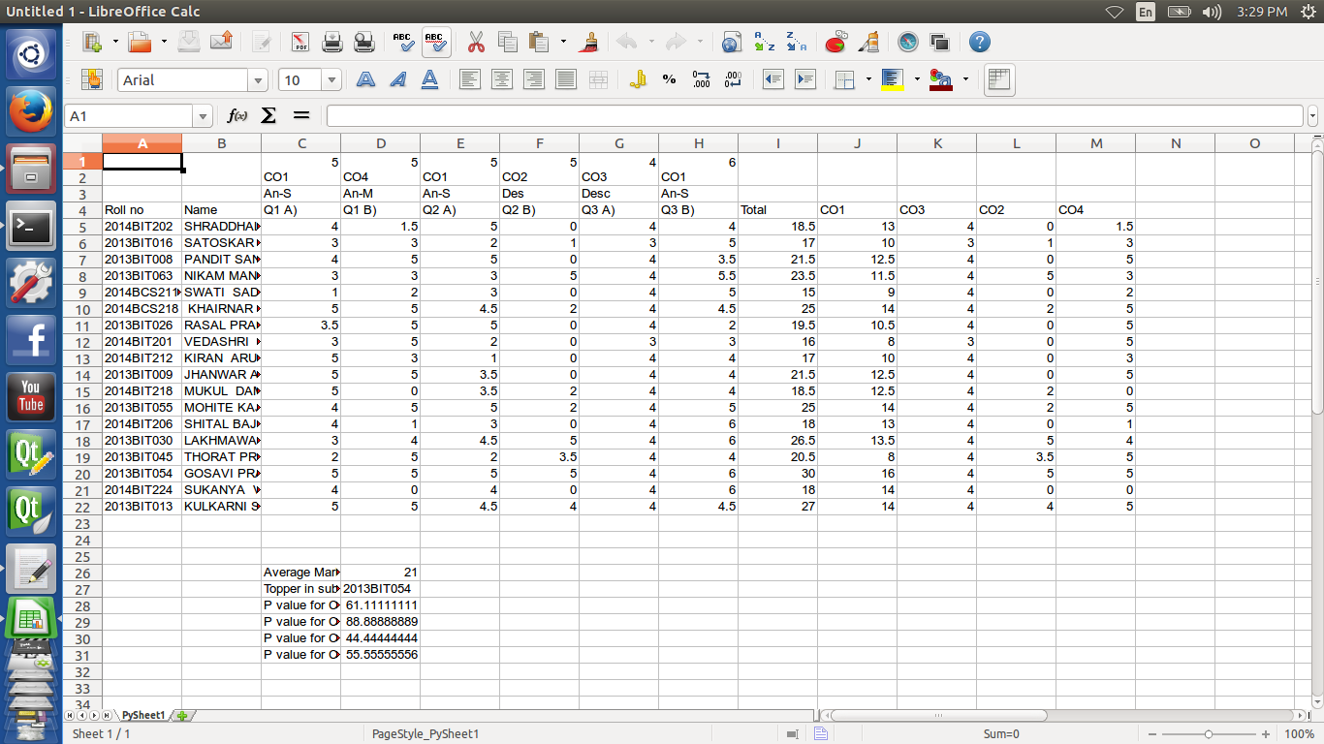

Slide 11
Thank You…..!!!

